Slide 1

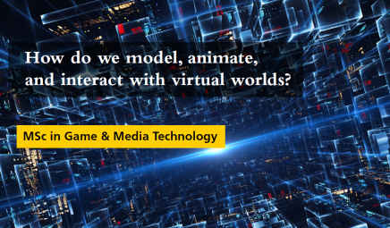
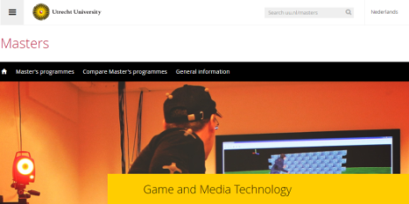

Welcome!
GAME AND MEDIA TECHNOLOGY - WEBINAR

Slide 2
Your crew for today
WEBINAR
Dr. Roland Geraerts
Programme Coordinator
Ishdeep Bandhari
Master’s student
Dr. Maarten Löffler
Programme Coordinator
(on chat)
Notes:
OPENING (5 minutes)
Introduction hosts + moderator
Explain set up to participants
How to get help with technical issues
How to ask questions
Q&A at the end

Slide 3
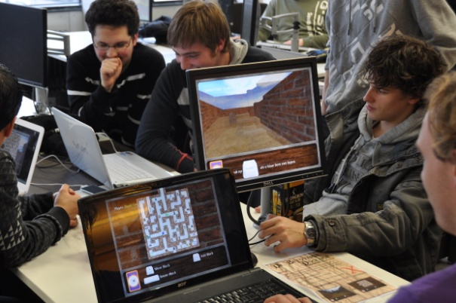
WEBINAR
Game & Media Technology
International research master, in English
Leads to a Master of Science degree (MSc)
Full time, two years
About 40 students per year
Training for developer or researcher,
.
in an R&D or academic environment
.
in the area of Game or Media Technology

Slide 4
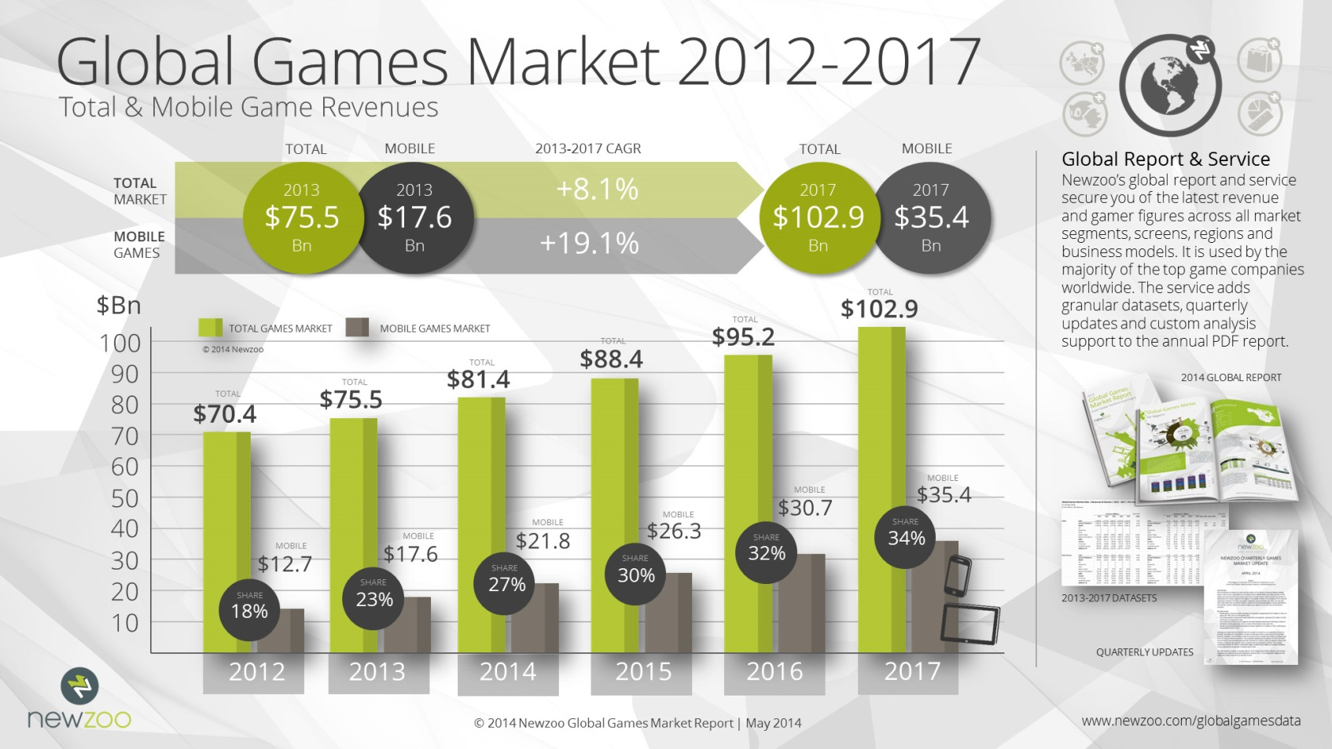
WEBINAR

Slide 5
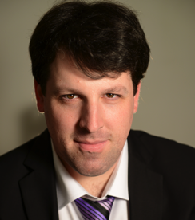
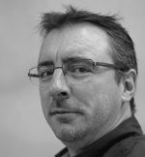
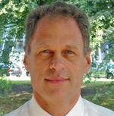
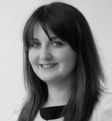
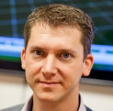
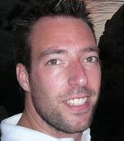
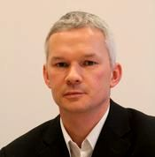
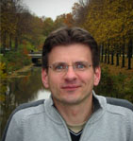
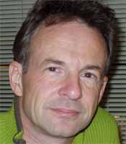

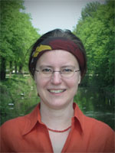

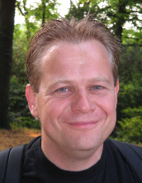
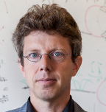
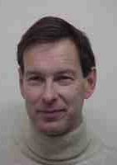
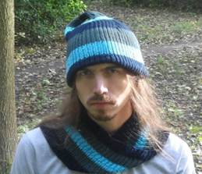
WEBINAR
Who are we?
Divisions
.
Virtual Worlds
Interaction Technology
Software Systems
Artificial Intelligence

Slide 6
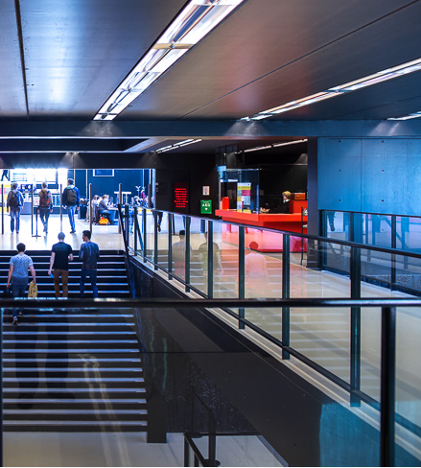
WEBINAR
Collaboration
Universities
Faculty of Sciences
Faculty of Humanities
Other universities (also abroad)
Utrecht School of the Arts
Research institutes
TNO, Waag Society, Thales
Companies
Entertainment games: Guerrilla, Gamious
Serious games: VSTEP, GreenDino, RANJ
Other: Cyclomedia, Movares, Google, …

Slide 7
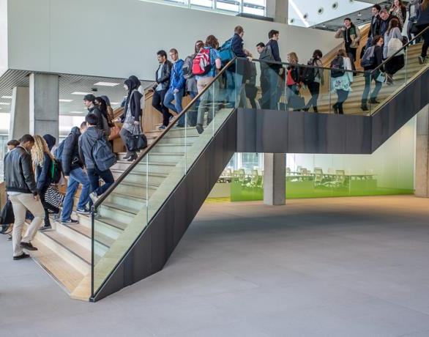
Programme structure
WEBINAR
First year: courses
      Deficiency courses
      At least 6 dedicated courses
      External courses
        Colloquium
Second year: projects
Optional: small project (1 block)
Thesis project: (3 blocks)
Colloquium
Individual study plan
with coordinator Maarten Löffler

Slide 8
Study scheme
 | Block 1 10 weeks | Block 2 10 weeks | Block 3 10 weeks | Block 4 10 weeks
YEAR 1 (60 EC) | Motion and Manipulation | Course | Computer Vision | Course
 | Course | Course | Course | Course
YEAR 2 (60 EC) | Course | Thesis Project Phase 1 | Thesis Project Phase 2
 | Small Project
Colloquium

Slide 9
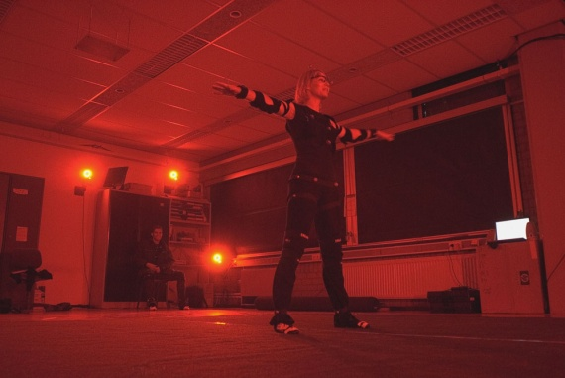
Courses
WEBINAR
Motion and Manipulation
Computer Vision
Computer Animation
Advanced Graphics
Geometric Algorithms
Game Physics
Multimodal Interaction
Multimedia Retrieval
Crowd Simulation
Pattern Recognition
Games and Agents
Mobile Interaction
Sound and Music Technology
Optimization and Vectorization

Slide 10
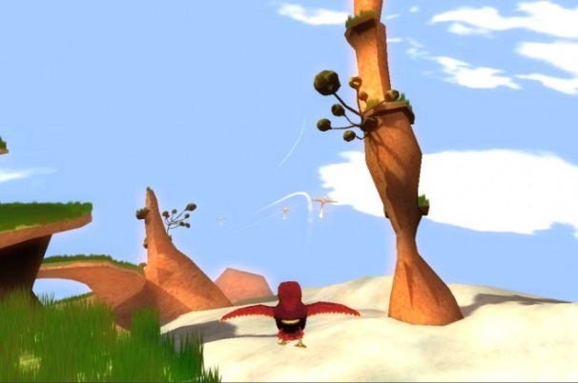
WEBINAR
Small project (optional)
Individual project,
or in a small group
15 EC
Different possibilities
- To pose and answer research
questions in game or media technology
- To develop a game based on technological innovation, together with art students
- Internship in a company

Slide 11

Master’s thesis
WEBINAR
Large full-time individual
research project
At the department or as an internship
15+25 EC (~ 7 months full-time)
Closely supervised by two staff members
Projects are linked to our research activities

Slide 12
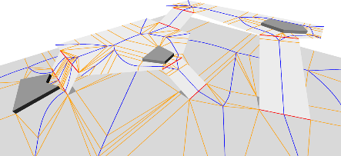
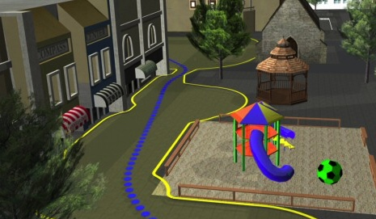
Example projects
Real-time simulation of the behavior of large crowds of characters
Notes:
www.youtube.com/watch?v=Nn8mWUmb0uE

Slide 13
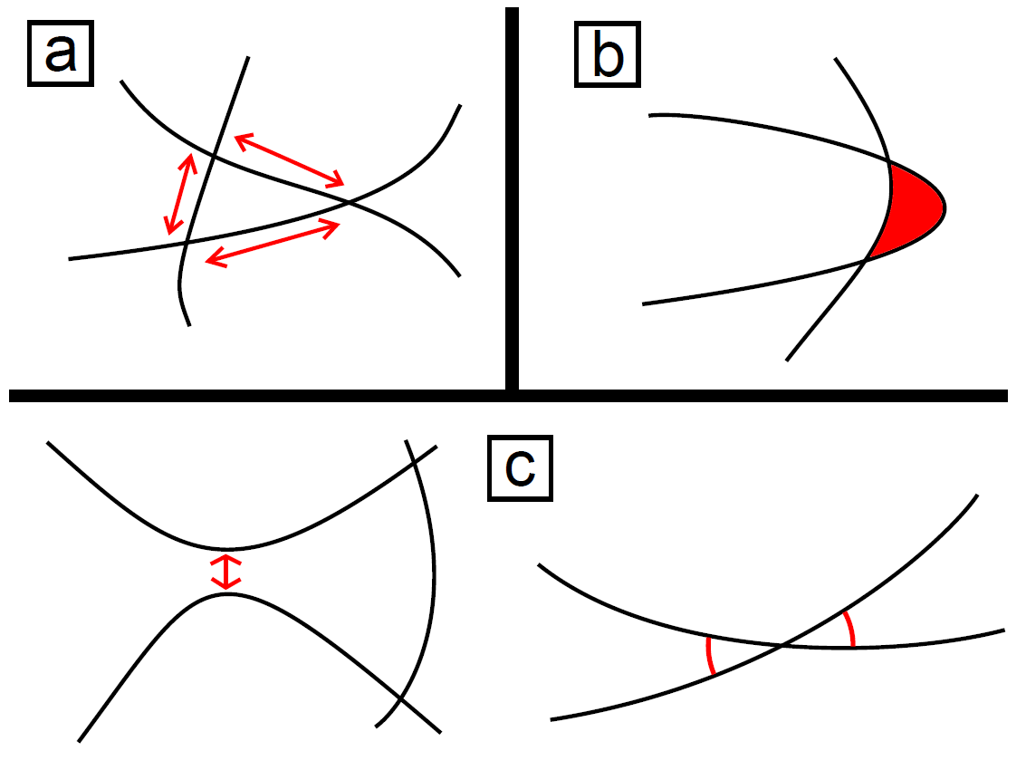
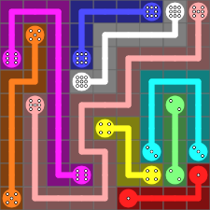
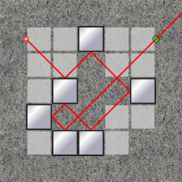
Example projects
Design and automatic generation of puzzles and puzzle games
Notes:
www.youtube.com/watch?v=Ag5p0y-qwxk

Slide 14
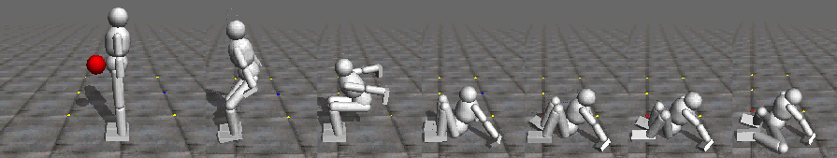
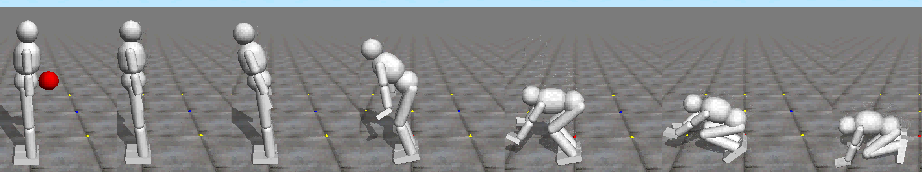
Example projects
Flexible Muscle-Based Locomotion for Bipedal Creatures
Notes:
https://www.youtube.com/watch?v=pgaEE27nsQw

Slide 15

Example projects
3D building generation from height data and areal photographs
Internship at Vicrea, Amersfoort

Slide 16
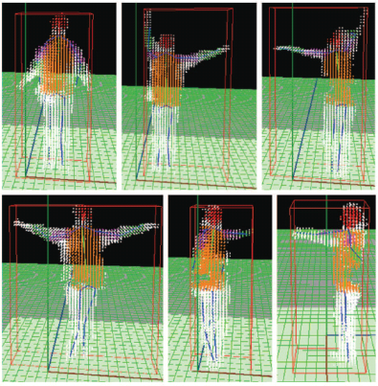
Example projects
Tracking and fitting 3D body models using multiple cameras

Slide 17
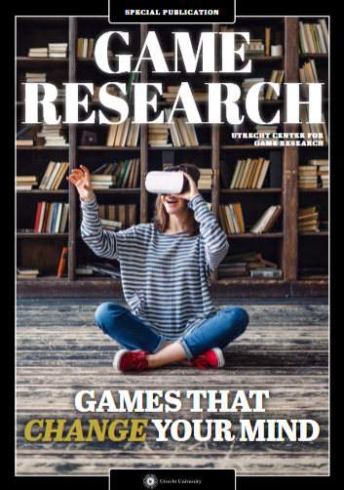
WEBINAR
What to expect from us?
High ranked programme, according to multiple
independent Dutch surveys (e.g. Elsevier)
Excellent teaching staff
(confirmed by internal and external audits)
High-quality facilities, like a game lab
and a motion capture lab
Game and Media Technology is unique
in Europe, in its focus and quality
.
The department is a national and international
focal point for Game Research

Slide 18
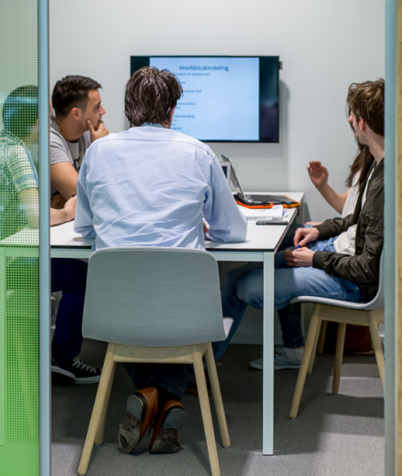
WEBINAR
What do we expect
from you?
Initiative, autonomy, and motivation
Commitment
  - All courses require active participation
  to be successful
- Active collaboration with students
and staff members
Sufficient level of English

Slide 19


WEBINAR
Extracurricular activities
Many students are active outside their studies
DGDARC (www.dgdarc.com)
student game development club
- Joint game projects
- Symposia, lectures, excursions
Dutch Game Garden (www.dutchgamegarden.nl)
incubator for new game companies
- Meetings
- Game Jams
- Advice and support for new companies

Slide 20
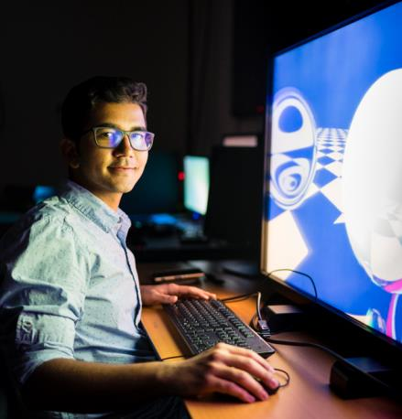
WEBINAR
Student story
…

Slide 21

After graduation…
97% of recent graduates has a job
Average search time for first job: 2 months
Job types
.
- Developing new technologies in game companies
.
- Software development at innovative multi-media companies
.
- PhD positions in academic research
.
- R&D positions in large companies (e.g. Philips or Microsoft)
.
- Creating a start-up company in game or media technology
Notes:
CAREER PERSPECTIVES (5 minutes)

Slide 22
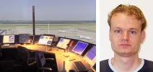
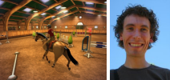
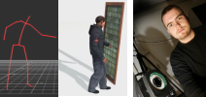
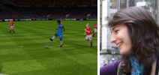
Alumni stories
Dennis Nieuwenhuisen
Researcher @ National Aerospace Laboratory (NLR)
Marin Hekman
Gameplay programmer @ Vanguard Entertainment Group
Ben van Basten
Developer @ Motek Medical, (former PhD student)
Diana Vasilescu
Game designer @Electronic Arts

Slide 23
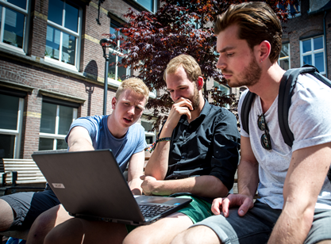
Entry requirements
WEBINAR
Bachelor degree in Computer Science
(or in Science with a minor in Computer Science)
Knowledge of
- Computer science and logic
- Data structures and algorithms
- Mathematics, calculus and linear algebra
- Probability and statistics
- Basic computer-graphic techniques
Motivation and talent
Proficiency in English
Academic skills

Slide 24


Application deadlines
WEBINAR
Deadline for non-EU students
For Dutch and EU students
01
04
2018
Scholarships
Utrecht Excellence Scholarship (non-EU)
→ Submit your application before:
1 February
DAY
MONTH
YEAR
01
06
2018
DAY
MONTH
YEAR

Slide 25
WEBINAR
Q
A
&

Slide 26


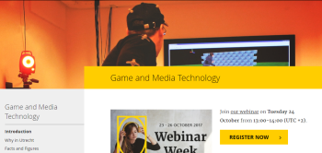

THANK YOU FOR JOINING!
WEBINAR
Questions?
Programme coordinators
Roland Geraerts & Maarten Löffler
coordinator.gmt@uu.nl
Student ambassador
Ishdeep Bhandari
i.p.s.bhandari@students.uu.nl
or visit the website: uu.nl/masters/gmt

